Slide 1
Everything Matters: Successfully Onboarding Your Staff to Avoid “New Hire Remorse”

Slide 2
Today’s Topics
Why onboard?
Onboarding defined
Onboarding versus orientation
Your new staff’s psychology
What about those millennials?
Onboarding best practices
Handling staff issues and new hire dynamics

Slide 3
But Before We Get Into This Exciting Topic…
Please tell us:
Your name/department/service area
Whether you have made any hires within the past six months
If yes, what is one thing you did
to onboard your new staff (besides
getting them their badge)

Slide 4
So Why Onboard?
Cut recruiting costs Cut recruiting costs | Increase productivity
Improve retention | Improve quality of work
Notes:
Speaker(s) should highlight how important this is for setting the tone and attitude a manager’s/supervisor’s employee has about them, their staff, and their organization. It also promotes better teamwork and loyalty, and better morale for both the new and unit staff (unit no longer has to pick up the slack when someone vacates, etc.) It also ensures better consistency as far as processes, procedures, and expectations among staff.
All of these reasons (and more) will create less work and hassle for you as supervisors if thoughtful onboarding practices are consistently and effectively implemented.

Slide 5
So Why Onboard?
Knowledge transfer | Compliance/Consistency
Grow unit staff | Increase engagement
Notes:
Consider the knowledge transfer that takes place when there is a mentor/trainer/buddy in place to specifically help someone acclimate and learn the tacit and explicit knowledge needed to be successful and “fit in” to the organization
Assigning a mentor (or someone to fulfill this kind of role) also helps them grow as well in terms of strengthening their leadership/communication/interpersonal skills

Slide 6
Onboarding Defined
New employees are assimilated into the workplace and given the tools and knowledge they need to become successful

Slide 7
Onboarding Defined
True onboarding should begin the moment your new staff accepts your offer and throughout the first year of employment—not just the first few days (or even weeks)

Slide 8
Onboarding Defined
Good onboarding involves your entire team—not just you
Notes:
Your new staff also has to embrace the process, be it through making it to mentoring appointments, completing assigned training, reading up on the organization, engaging our Strategic Plan, etc.

Slide 9
Onboarding Defined
Your new employee also shares significant responsibility in making his/her onboarding a success

Slide 10
Orientation Versus Onboarding
Orientation: We use PeopleSoft for timekeeping
Onboarding: Showing the employee how to do it
Orientation: We offer training
Onboarding: Following up to ensure staff gets it
Orientation: Here’s our department’s Strategic Plan
Onboarding: Giving staff the time to read the Plan and discussing how s/he fits into and contributes to the department, division, branch, and unit

Slide 11
The Psychology of Your New Staff
To your new staff, everything matters
The first 90 days matter most

Slide 12
The Psychology of Your New Staff
Since your new staff is in unfamiliar territory, s/he is much more alert and sensitive to his/her surroundings (messy workplaces, sarcasm/staff interactions)
Is this you? →
Notes:
Within the first 90 days, your staff is most observant and impressionable. Remember that the staff is really paying attention to what kind of work environment s/he is entering (e.g. lax, low morale, unhappy, cohesive, friendly, etc.). These are elements a supervisor/manager may not even notice anymore, but they are extremely visible to new staff.

Slide 13
The Psychology of Your New Staff
Because s/he feels vulnerable and uncertain, this will cause him/her to leap to conclusions before having enough information
Your new staff will also notice instances where s/he feels they
were not onboarded
Notes:
It’s important to note that even if a supervisor/manager thinks something is insignificant in terms of onboarding, they should not be surprised if their staff still feels s/he made a lapse in their process (not introducing them to a particular person, showing them a particular process, etc.)

Slide 14
The Psychology of Your New Staff
It’s vital to convey three particular sentiments to new staff:
“We’re happy you’re here,”
“You chose a great organization and
here’s why…”
This is why your job is
important…”

Slide 15
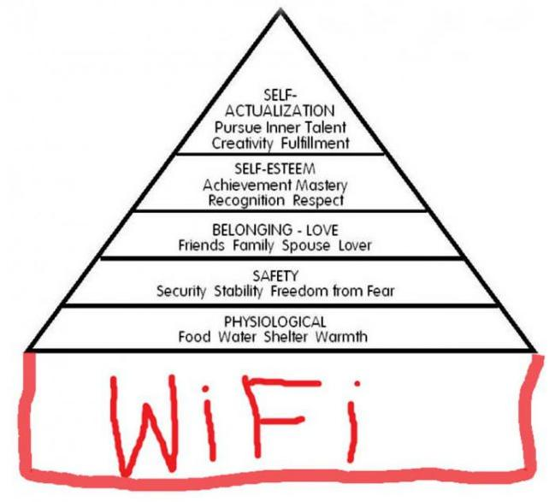
The Psychology of Your New Staff
If you convey these, you will tap into three critical motivators that increase successful engagement:
The need for meaning and purpose
The desire to matter
The desire for esteem

Slide 16
So Remember…
Every choice, action, and communication you have during the first three months in particular has potential consequences—every decision carries and implicit message about you, your unit, and your organization

Slide 17
And Now a Special Word About Millennials
Most Millennials will expect strong onboarding efforts—don’t leave them behind
“Don’t you dare ignore us”
Notes:
According to the most recent National Association of State CIOs survey, “it is estimated that a full 86 million millennials will be in the workplace by 2020—representing a full 40% of the total working population.”
Discuss the reasons why this is: Though everyone expects/deserves good onboarding regardless of age, many Gen Yers will see the workplace as their new “home” and their supervisor/manager as their surrogate “parent.” Therefore, they will expect a strong and genuine interest in their continual growth and development, and they will look forward to regular feedback and help with adjusting.

Slide 18
And Now a Special Word About Millennials
Keep “score”: they identify with bench-
marks and measures of success/leveling
Everyone gets a trophy
Strike a balance between structure and
autonomy
It’s now about
“work life integration”
Notes:
Highlight that work/life integration is different from work life balance—it involves blending work and life together. While Boomers have been trained to shut “off” their personal life at work, Millennials (and younger) are now accustomed to mixing the two (getting on FB at work and answering a work email after hours on their phone). The inclusion of telework as being more of a standard practice also blurs the line between personal and professional outlets. Finally, there is a fear of missing out within the millennial culture, hence the need to constantly be “tuned in” via social media. Understand that your millennial workforce is coming to you with this mindset
They will appreciate any efforts their supervisor/manager makes that shows they are keeping “score” of their successes—they have been raised with a “benchmark” mentality (test scores equal achievement/accomplishment). Also, think of video games/iPhone games (Candy Crush, Farmville)—these are very “task” oriented—complete one task, get points, rewards, etc. They often carry this expectation over into the workplace. They have also been raised as a generation where everyone “wins” as long as they try.
Gen Y craves both structure and autonomy at the same time—the key is to try and offer a balance of each so they feel as if you care, but also respect their desire to be independent.
Remember that you may have to work harder for their loyalty

Slide 19
A Word About Transfers
The hidden danger is to think
they don’t need onboarding since
they have already “worked for the state”
We’ve seen this fail firsthand
Transfers deserve all the time and attention as newbies, but maybe for not as long
Notes:
Keep in mind that just because someone has done the same type of work at another department, the process may vary substantially from you how your unit does it.

Slide 20
Onboarding Phases
There are four critical phases:
Pre-arrival
First Day
First Week
First 90 Days year)
Notes:
Point out that though onboarding technically should involve the entire first year, these stages are of special importance

Slide 21
Before Your Employee Starts
Inform current staff; ask what they wish they would have known when they started (you might be surprised)
Secure a “Welcome” letter from your Branch Chief or Deputy Director
Notes:
When informing new staff, consider sharing any non-confidential information of interest you can share (any hobbies, background information, etc.)
REFER TO THE WELCOME LETTER IN PACKET—mention that per our last NEO evaluations, most staff indicated that what they appreciated the most was ANY kind of interface with executive staff—this is a simple way to set that tone

Slide 22
Before Your Employee Starts…
Call them (or email):
Welcome staff to the unit
Address questions and
concerns (e.g. salary)
Inform about current and upcoming projects of interest
Offer to provide a tour
Notes:
REFER TO THE ONBOARDING EMAIL SAMPLES IN PACKET

Slide 23
Before Your Employee Starts
Direct them to website links of interest
Ensure workstation is set up
Badge access is arranged
Notes:
Consider directing them towards information that will help them know what the department’s mission/goals/customers/line of business is, who you serve, etc. Would be helpful if they could see the Strategic Plan, etc.

Slide 24
Before your Employee Starts
Make an appointment with their HR Specialist
Compile relevant reference materials
Notes:
REFER TO PRE-ARRIVAL CHECKLIST IN PACKET

Slide 25
Before Your Employee Starts
Assign a mentor/trainer—whatever mechanism suits your unit’s culture
Understand the difference between these concepts
Notes:
REFER TO MENTORING RELATIONSHIPS HANDOUT AND MENTORING AGREEMENT HANDOUT

Slide 26
The First Day
Be accessible
Give a tour of your facility
(if not done prior to start)
Introduce them around—
bring in a treat?
Notes:
Remind them that the importance of their role as a first line sup can not be overstated. Research indicates over and over that an employee’s relationship with his/her first line supervisor is often the most critical factor in whether that employee stays

Slide 27
The First Day
Escort him/her to HR for paperwork
Ask your supervisor to stop by—introduce him/her to the Branch Chief
Introduce your new staff
to their mentor/trainer/
buddy

Slide 28
Have That First Meeting
Have 1:1 and cover the following:
How their job supports the department
Mention that you will have a specific onboarding plan for them
Notes:
Be sure not to make this meeting all about red tape and rules.
Also see if their new staff is willing to share any information about themselves (how they like to be trained, interests, etc.)
Let your new staff know that they will receive a New Employee Onboarding Plan within the next week or so to assist them in learning their new job

Slide 29
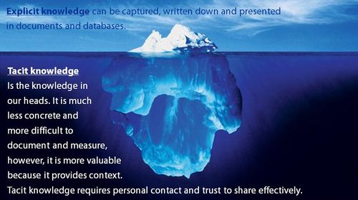
Have That First Meeting
Tacit and explicit knowledge of interest
Your preferred communication style
Ask them to share, too
Notes:
Examples of good tacit and explicit knowledge to discuss include explaining how their job specifically supports the organization, where they lie organizationally (chain of command), your own personal expectations/management style, culture of the unit, who the key players are in the organization, and their duty statement
Overall, by the end of the first day, they should leave knowing they have joined the right team and that you are vested in their success, that you have provided resources, and that their job relates to the organization as a whole and that they are valuable.

Slide 30
The First Week
Do regular check-ins
Provide small assignments that allow your staff to shine and demonstrate their abilities
Continue to direct them toward learning resources to increase productivity

Slide 31
The First Week
Introduce them to key players
Take them to meetings
Schedule any training needed
Allow job shadowing if helpful

Slide 32
The First Week
Develop and discuss a New
Employee Onboarding Plan:
Should be viewed as a helpful
roadmap; allow flexibility
Should outline milestones, formal/informal training, and available support
Goal = spell out what they will learn/do, how they will get there, and what assistance is available
Notes:
REFER TO THE ONBOARDING PLAN HANDOUT AND THE FIRST DAY (OR WEEK) CHECKLIST IN THEIR PACKET

Slide 33
The First 30-90 Days
Give assignments with more complexity, variety, and meaning
Schedule regular meetings
Determine if additional training could be helpful

Slide 34
The First 30-90 Days
Continue to provide/solicit feedback
Provide timely probationary report
Watch carefully to ensure your staff is being accepted by your unit
Notes:
For their probationary report, make sure it clearly outlines their staff’s successes and/or challenges at the 90 (or 120-day mark, depending on the length of the probation). Managers/Supervisors can use their “New Employee Onboarding Plan” to help them complete a good probationary report.
Be particularly observant of whether other unit staff are being passive aggressive or unsupportive (this is expanded upon later)
REFER TO THE 30-60-90 DAY INTERVIEW QUESTION HANDOUT IN THEIR PACKET

Slide 35
The First Year…
For most employees, the “newness” and learning curve lingers
Ask for and provide consistent, constructive feedback
Help them determine career goals and use an IDP to help meet them
Notes:
CHECK FOR UNDERSTANDING/QUESTIONS HERE

Slide 36
When You Have a Bitter Bear in the House…
Watch out for
Staff who feel “threatened”
Silent sabotagers
Negative ringleaders
Whatever the case, don’t
ignore it and hope it will
diffuse on its own—it won’t
Notes:
Sometimes certain staff can feel threatened by new (often younger) staff who they do not feel have “earned” their position, they may feel they deserved the position more, etc.

Slide 37
Watch Out for Staff Who…
Avoid assisting/interacting with new staff
Withhold information
Gossip about your new staff
Are overly judgmental
Display various passive
aggressive behaviors
Notes:
Specific examples to watch for– staff who provide weak excuses for excluding the new staff from projects/meetings, staff who don’t recognize that new staff (even if they are not new to state service) need time to acclimate to your organization’s culture, not sharing information that would obviously be helpful to new staff, etc.)

Slide 38
How to Address the Issue
Have a conversation:
Find out the real issue
You may need to communicate why your new staff does not know something yet, what they do know…

Slide 39
How to Address the Issue
Indicate you won’t tolerate
behaviors that impact a
positive group dynamic
Make sure your new staff knows that you have addressed the situation and are handling/monitoring it
Notes:
BE SURE TO CHECK FOR UNDERSTANDING HERE

Slide 40
So Let’s Assess Your Current Practices…

Slide 41
Ask Yourself…
Is the first day/week mostly transactional in nature?
Have you buried your staff in manuals
and processes to read,
like this miserable guy?

Slide 42
Ask Yourself…
Is it easy for your staff to ask for what they need?
Do you do all you can do to ensure hires feel welcome? Could you do more?
Are you truly accessible, or do you rely too heavily on senior staff?
Do you help your staff see the big picture and their role?

Slide 43
Ask Yourself…
Do you regularly encourage feedback?
Do you use some form of onboarding plan?
Do you use mentors?
Do new staff feel their
goals are attainable?
Do they know you care?

Slide 44
In Closing…
Despite its benefits, onboarding is not the only solution for creating productivity and engagement
It must be strategic rather than simply transactional
It won’t compensate for other problems that create discord and turnover

Slide 45
In Closing…
However…
With careful planning and
consistent delivery, it will generate
both short and long term benefits
It will make your job easier in the long run
Don’t feel you need to incorporate all of these tools—choose what best suits your management style/unit culture

Slide 46
Need Some Help?
We’re here to assist…
Check us out online at: http://cio.ca.gov/OPD/wp/it_workforce_planning.html
Or call us…
Jennifer Hamman, 431-3609 jennifer.hamman@state.ca.gov
Don Gloor, 431-3610 don.gloor@state.ca.gov

Slide 47
Final Questions? Comments?
That’s all folks…
Go forth and onboard!

Slide 48
Resources Used/Consulted
California Department of Human Resources website
“Getting On Board: A Model for Integrating and Engaging New Employees,” by Booz, Allen, and Hamilton Consulting Group
“Tools and Techniques for Successful Onboarding,” Office of State Personnel, North Carolina
“If You’re Serious About Onboarding Success, Remember This Mantra,” David Lee
“Five Effective Techniques for Onboarding New Hires,” Angel Business Advisors
“Employee Onboarding: A Manager’s Guide to Orientation for New Employees,” Government of Saskatchewan
“All Aboard! Does Your Onboarding Process Lead to Employee Engagement or Buyer’s Remorse?” David Lee
“Work Life Integration: The New Norm,” Dan Schwabel
Everyone Gets a Trophy, Bruce Tulgan

