Slide 1
Financial Analysis Worksheets (FAWs) Training

Slide 2
FAWS TRAINING
SIMM
BUDGET REQUEST TIMING & BUDGET LETTERS
LINKS & ATTACHMENTS
STEPS & WHO TO INVOLVE
REVIEW CRITERIA & TIPS
FAWS HANDS-ON & TRAINING EXERCISES
SAMPLE
FAWS OVERVIEW

Slide 3
TODAY’S FAWS TRAINING
SIMM
BUDGET REQUEST TIMING & BUDGET LETTERS
STEPS & WHO TO INVOLVE
FAWS HANDS-ON & TRAINING EXERCISES
FAWS OVERVIEW

Slide 4
JUNE 24 TRAINING
LINKS & ATTACHMENTS
REVIEW CRITERIA & TIPS
FAWS HANDS-ON & TRAINING EXERCISES (Continued)
SAMPLE

Slide 5
FAWS OVERVIEW
FAWS OVERVIEW

Slide 6
Financial Analysis Worksheets (FAWs)
Overview
Intent: Document the financial analysis conducted and compare the current operations costs to the proposed alternative costs and financial benefits, including:
Overall Staff Size (Current & New)
Planning & Ongoing Costs
Number of Fiscal Years (FYs) to Implement, i.e., Planning thru M&O (M&O = Implemented for one complete FY)
Financial Resources Source(s) Needed
Alternatives Considered
Outcome: A detailed record of the financial analysis used to identify the total estimated project cost, the financial impact on future operations costs, and the funding source(s), which ultimately contribute to:
Good Investment Decisions
Project Transparency
Fiscal Accountability

Slide 7
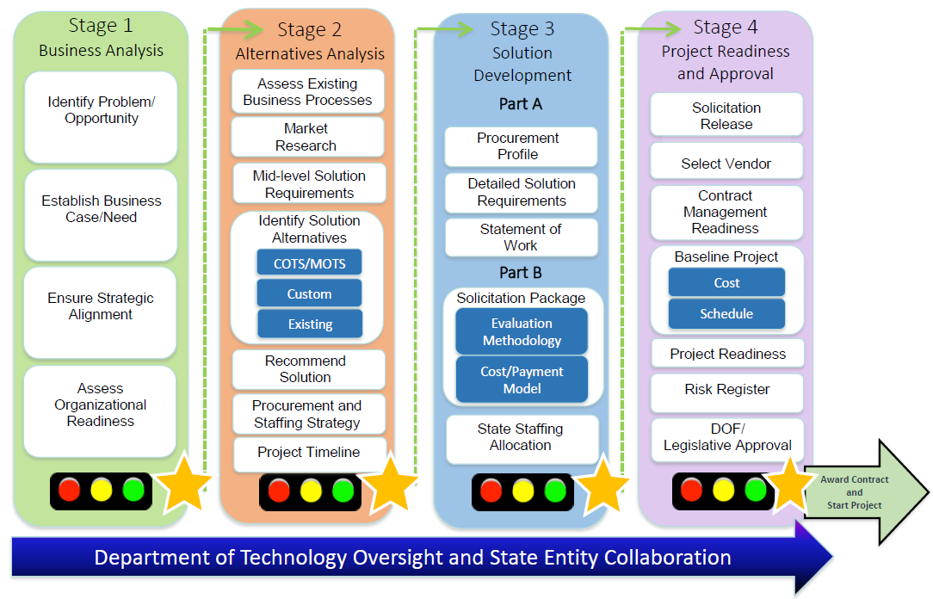
Project Approval Lifecycle
Create FAWs
May Update FAWs
Baseline FAWs
Notes:
Image of the PAL.
FAW’s created in Stage 2 Alternatives Analysis (Attach in Section 2.14 Financial Analysis Worksheets).
If projected costs and/or financial benefits change in Stage 3 and/or Stage 4, submit updates along with associated deliverable.

Slide 8
FAWS SIMM
SIMM

Slide 9
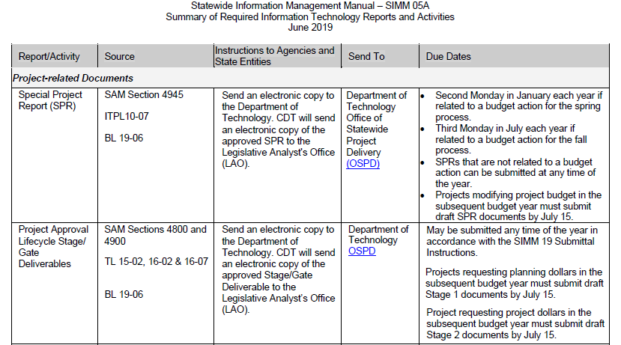
SIMM 05A Reports and Activities Excerpt

Slide 10
SIMM 19 Project Approval Lifecycle
SIMM Project Approval Lifecycle (PAL) guidelines and forms located in:
SIMM 19 Project Approval Lifecycle
SIMM 19F Financial Analysis Worksheets
http://www.cio.ca.gov/Government/IT_Policy/SIMM_19/SIMM19.html

Slide 11
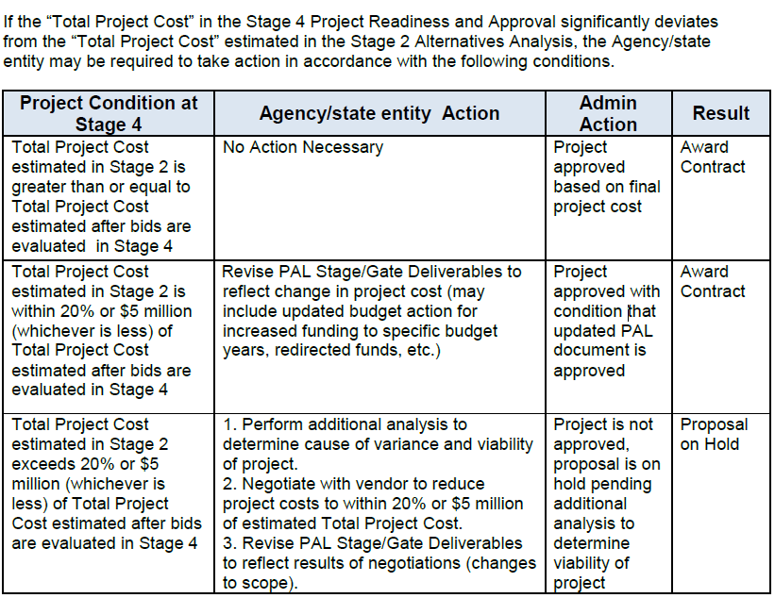
Cost Changes from Stage 2 to Stage 4
Excerpt from SIMM Section 19D Stage 4 Project Readiness and Approval, Section 4.13 Cost Baseline (Page 25):

Slide 12
FAWS BUDGET
BUDGET REQUEST TIMING & BUDGET LETTERS

Slide 13
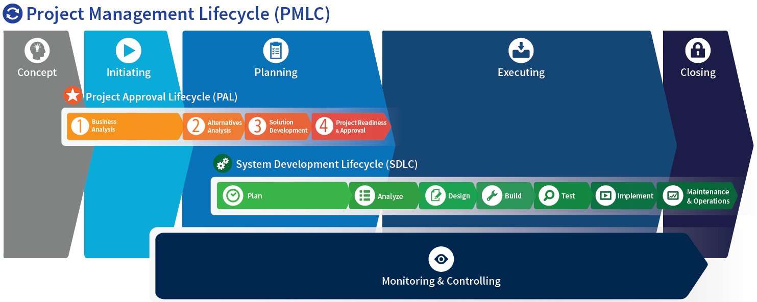
BCP Funding Needed?
Timing of Resource Request
$
$
Planning Funding for PAL Stages 2, 3, and 4 can be requested with an S1BA (approved prior to funding approval).
Project Funding (Executing Process Phase activities) can be requested in a separate BCP with an approved Stage 2 (or Stage 3 or Stage 4, as applicable) prior to funding approval.

Slide 14
Funding Request Deadlines
$

Slide 15
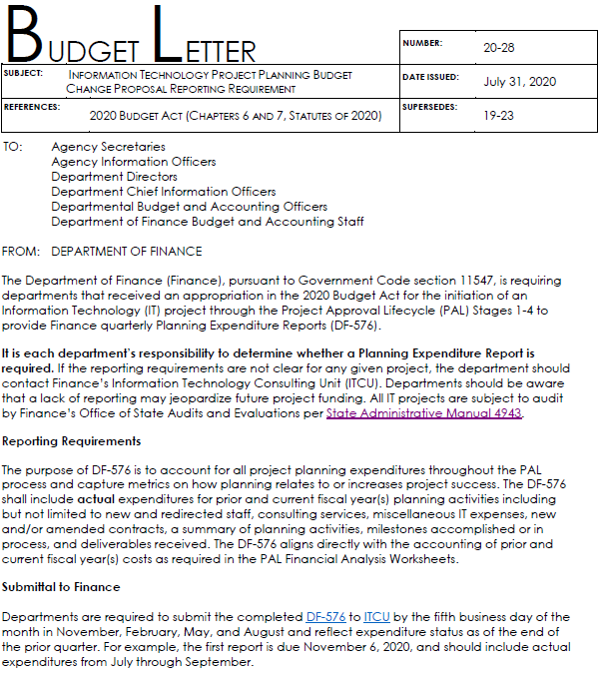
PAL Planning Expenditures
Planning $$ Used?
A DF-576 to DOF May Be Required.

Slide 16
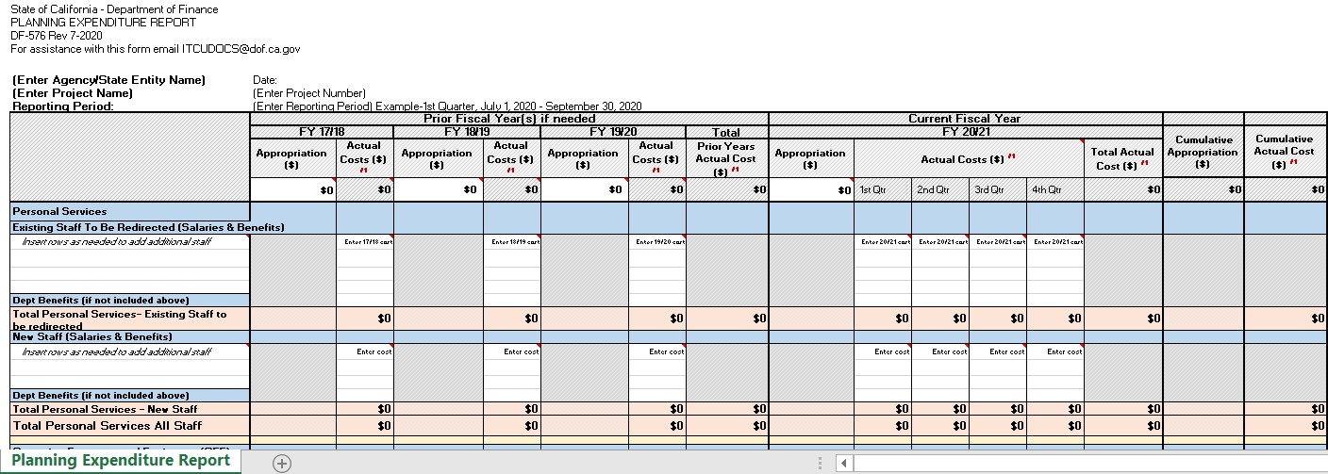
PAL Planning Expenditure Reporting
Planning $$ Used
Questions?
Contact Your PAO Manager or DOF IT Consulting Unit

Slide 17
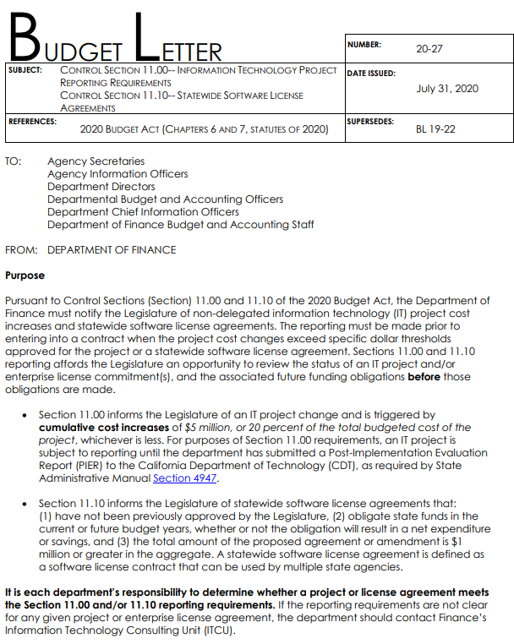
Project Increase Over $5M/20% Increase
Cumulative Project Cost Increase $5M or 20% of total ?
A DF-12 May Be Required.

Slide 18
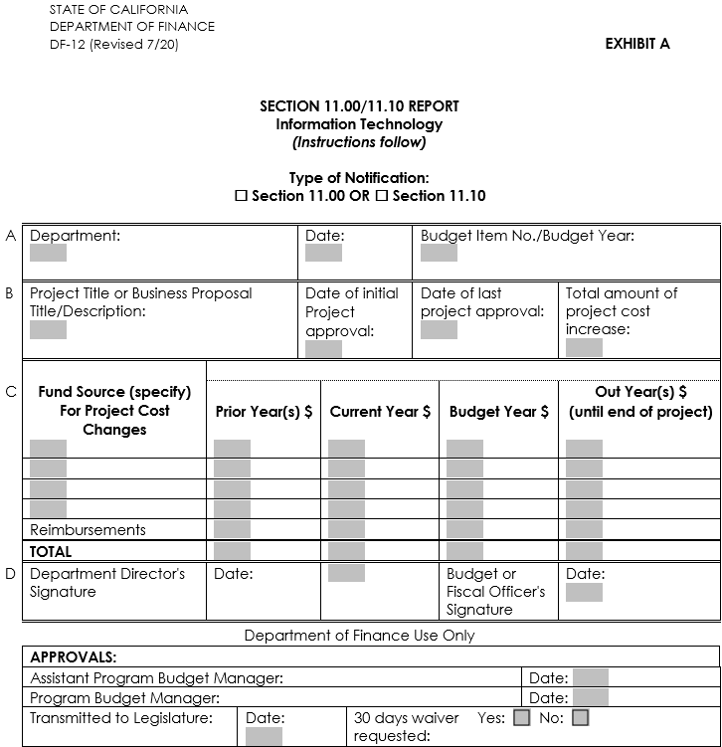
Project Expenditure Increase $5M/20%
Project Increase by $5M or 20%
Questions?
Contact Your PAO Manager or DOF IT Consulting Unit

Slide 19
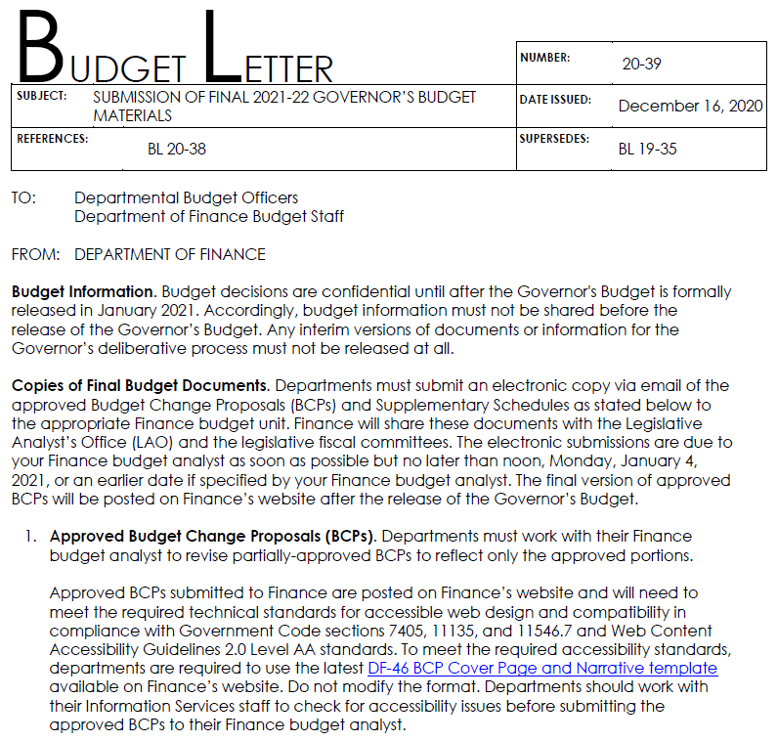
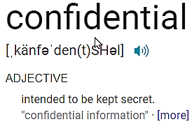
Budget Confidentiality

Slide 20
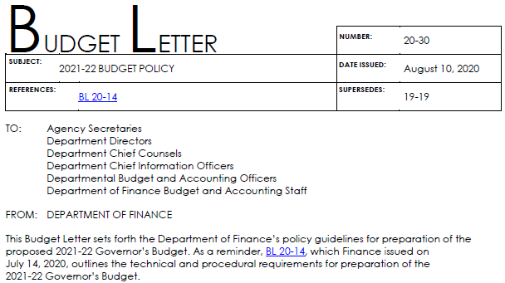
Budget Confidentiality

Slide 21
FAWS STEPS & WHO
STEPS & WHO TO INVOLVE

Slide 22
Steps to Complete the FAWs
Step 1
Identify existing (current) costs for program operation and supporting information systems.
Step 2
Estimate one-time project costs for each alternative considered.
Step 3
Estimate future operations costs for each alternative considered.
Step 4
Identify funding source(s) for selected alternative.
Step 5
Update as additional information determined until baseline final FAWs.
Notes:
Strengthen and transparent investment decision-making based on clear and complete picture of project costs.

Slide 23
Who to Involve

Slide 24
Who to Involve - Current Ops Cost FAWs
Step 1: Identify existing (current) costs for program operation and supporting information systems.
Program Business Sponsor
The Program Business Sponsor should have a complete understanding of the current program and be able to assist in identifying the current program areas impacted.
Budget Office
The Budget Office team serves as lead resource in the development of the FAWs during planning and has access to the current program costs
Entirely New Program
Experts in the budget process, budget timelines, and cost estimation methods.
If an entirely new program area (rare), no current costs exist.
Notes:
Strengthen and transparent investment decision-making based on clear and complete picture of project costs.

Slide 25
Who to Involve – Alternative(s) Planning (Stage 2 – 4) FAWs
Note: Each department may involve other staff and/or program areas as needed. This is only a sample of the more common teams involved.
Steps 2, 3, & 5: Estimate one-time & future operations project costs for each alternative considered. Update FAWs as needed based on known information.
Program
Assist with solution requirements and program need, and obtains Business Sponsor buy in and support.
Admin & Procurement
Assist with market research, procurements, and staffing needs and planning.
IT Support
Project Management
Information Security
Enterprise Architecture
Budget Office
Manage the project team, assigns specific roles, deadlines, and develops overall project plan. Ensures SME involvement in project.
The data custodian organization for the existing or proposed solution.
Oversees and validates the security and privacy handling of
information by the state entity and ensures suitable security control.
Articulates alternative concepts, explores and evaluates alternatives, and analyzes solution recommendations.
Leads the development of the Financial Analysis Worksheets.
Notes:
Strengthen and transparent investment decision-making based on clear and complete picture of project costs.

Slide 26
Who to Involve – Alternative(s) FAWs Funding
Note: Each department may involve other staff and/or program areas as needed. This is only a sample of the more common teams involved.
Step 4: Identify funding source(s).
Program
Identifies known funding sources with Budget Office input, and obtains Business Sponsor buy in and support. May develop Budget Change Proposal (BCP) information aligned with funding.
Project Management
Budget Office
Manage the project team, assigns specific roles, deadlines, and develops overall project plan. Ensures project funding coordination and development of BCP content.
Leads the FAW funding needs and any BCP development, timing, and processes.
Notes:
Strengthen and transparent investment decision-making based on clear and complete picture of project costs.

Slide 27
FAWS HANDS-ON
FAWs Hand-On: Executive Summary & Summary Worksheets

Slide 28
Executive Cost Summary Worksheet
Intent: Summarize the selected alternative’s planning costs (before project), project costs (during project), and future IT staff and operations costs (after project or continuing) into one sheet.
Outcome: Provides a summary of the total project costs for the selected alternative. Summary cost information will be used to identify the total project costs and may be transferred to other cost tracking sheets (e.g., project status report) to be used as the project’s baseline.

Slide 29
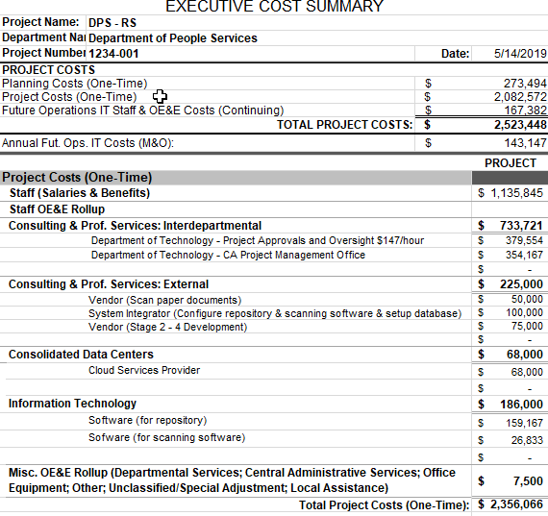
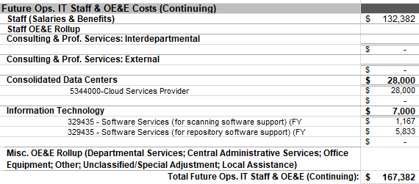
Executive Summary Worksheet
Step 1
Enter Project Name
Department Name
Important
All other worksheets’ project information (project name, project number, etc.) populates from Step 1.
Project Number
Date (This is helpful for versioning purposes)
Executive Summary data automatically populates as data is entered in the Alt -1 Project & Alt 1 -Future Ops.
TOTAL PROJECT COST
Total Project Costs information to be used in the Stage 4 Project Readiness and Approval (S4PRA) Letter.
Note: This information must be consistent with the S4PRA Cost Baseline information.
Notes:
Executive Summary Sheet calculates automatically based on entries in Alt 1- Project and Alt 1- Future Ops.
Project Cost information to be used in the S4PRA approval letter and sets the cost baseline for the project.

Slide 30
Summary Worksheet
Intent: Summarize the costs and financial benefits of each alternative into current operations costs (before project), project costs (during project) and future operations costs (after project).
Outcome: Chronological presentation of key financial information for decision-making. Provides a basis to evaluate each alternative in terms of the cost to implement each alternative and the positive or negative impact on operations (positions and dollars) resulting from the implementation of the system.
Important: The Summary Worksheet automatically populates as data is entered in Current Operations and each respective alternative worksheet (Alt # Project & Alt # Future Ops)

Slide 31
Summary Worksheet
Average Current Operations Costs
(Before Project) – Derived from information inputted into Current Annual Operations Worksheet (Current Ops); average of multi-year operations cycles
Planning Costs
(During Project) – Derived from information inputted into the Project Cost Alternative Worksheet; year-by-year cost to plan the project
(one-time costs)
Project Costs
(During Project) –
Derived from information inputted into the Project Cost Alternative Worksheet; year-by-year cost to implement the project (one-time costs)
Notes:
Summary Sheet calculates automatically based on entries into Current Operations, Alternative Costs, and Future Costs
Average (Current, Project, Future) Costs Calculated and Populated
Fiscal Years for Current and Project Years typically align with each other; however, if current costs remain the same each year without fluctuations, it may contain fewer years with entries

Slide 32
Current Operations Costs Worksheet
Intent: Identify and document the current annual cost to operate the program and supporting information system as they exist before an alternative solution has been implemented.
Outcome: Provides information regarding the actual costs and relative size of the current business program and IT operations. Provides a baseline for the change in operations costs that may occur after the implementation of an alternative solution.

Slide 33
FAWS HANDS-ON
FAWs Hands-On: Current Operations Worksheet

Slide 34
Personal Services – Classifications of existing staff that currently support business processes and IT systems impacted by the proposal.
Current Operations Costs (Cont.)
Program/IT – Differentiate business program staff from the IT staff supporting systems and infrastructure (if one exists).
Monthly Salary – Current salary of each existing classification, not including benefits.
Tenure/Time-Base – Identify positions as authorized/reflected in annual supplemental schedule of salaries and wages (Permanent, Temporary, Exempt, or Board).
Optional Benefit Rate (%) – This optional field may be used when you have classifications with different benefit rates.

Slide 35
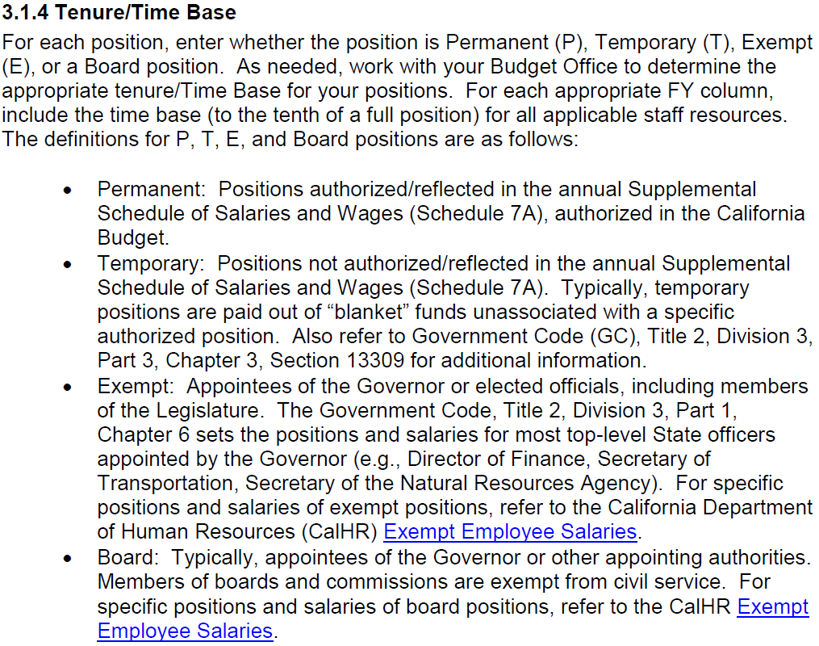
Current Operations Costs (Cont.)
Current Operations Costs (Cont.)
Excerpt from SIMM Section 19F.1 Financial Analysis Worksheets Preparation Instructions, Page 10:
Tenure/Time Base Information
POSITION TYPE
P = Permanent
T = Temporary
E = Exempt
Board = Board

Slide 36
Current Operations Costs (Cont.)
Current Operations Costs (Cont.)
Current Annual Operations Costs – Number of positions and associated costs for entire multi-year operations cycle. Show cost of current operations as if the project is not undertaken and operations continue in their current state. Note: If costs are consistent on a FY basis, only one year needs to be shown.
Positions – Number of positions for each classification, identify partial positions (e.g., 0.1) as needed.
Dollars – Automatically calculates annual salary based on monthly salary, benefits, and number of positions. If the optional benefits rate was used, the “Dollars” total with include the combined salary plus benefits.
Average Current Operations Costs – Automatically calculates based on total average of all years.
Identify the number of years of current annual operations costs to accurately calculate averages.
Note: Up to ten years of current annual operations costs may be entered.

Slide 37
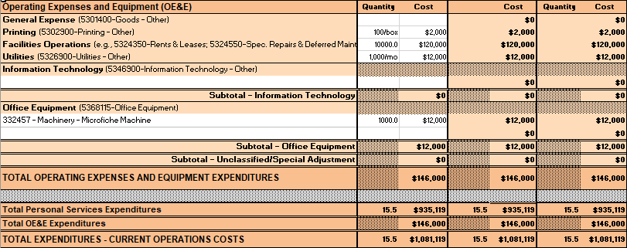
Current Operations Costs (Cont.)
Current Operations Costs (Cont.)
Note:
“Local Assistance” – Expenditures of state funds provided to counties, cities, and special districts. This may not be applicable to most projects. The Local Assistance (rows 198 – 203) are currently hidden and may be unhidden as needed.
Operating Expenses and Equipment (OE&E) – Expenses that occur through normal business operations. Categories broken down by items of expense used in the BCP fiscal sheets. Additional items may be added but must comply with FI$Cal definitions and cost codes.
Staff related OE&E

Slide 38
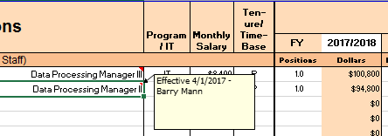
Quick Tips Current Operations Costs Worksheet
Use Mid-Range Salary. Use the classification’s mid-range salary for positions needed during your project planning and future operations. This will help to align costs with any Budget Change Proposals (BCPs) needed. For more information, contact your Budget staff.
Use the “New Comment” function in Excel to add a brief explanation. To do this, go to the Review menu tab and select New Comment. Include information helpful to explain contents.
New “Comments” Field. A new comment field was added at the bottom of each sheet for additional information related to your worksheets.
Hide Rows and/or Columns Not Used. For ease of viewing, hide rows and columns not used. This makes it easier to identify sections with information.

Slide 39
FAWS TRAINING EXERCISE
FAWS Training Exercise 1:
Current Operations

Slide 40
EXERCISE 1 Current Operations Costs Worksheet
The Department of People Services proposes to improve access to records by digitizing paper records and closing down its records warehouse. The Records Unit currently has 10 full time and five (5) half time warehouse workers (mid-salary $3,699), as well as one (1) Staff Services Manager I (mid-salary $6,796) and two (2) Office Technicians (General) (mid-salary $3,455) (all permanent). The cost for benefits is 30%.
Rent for the warehouse is $10,000 per month, utilities are $1,000 per month, and the cost to maintain the microfiche machine is $1,000 per month. The warehouse purchases 100 boxes of paper per year at the cost of $20 per box.
Note: There are no fluctuating on-going costs from Fiscal Year (FY) to FY.

Slide 41
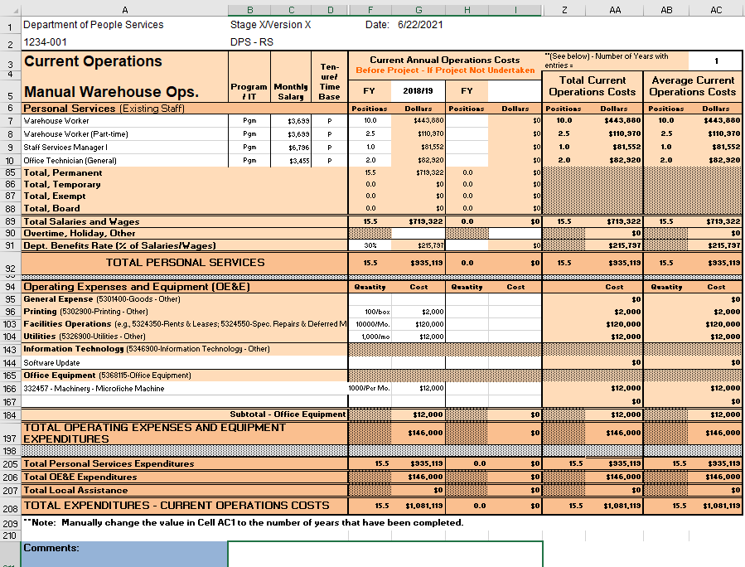
Exercise 1 - Results Current Operations Costs Worksheet
Results:

Slide 42
FAWS HANDS-ON
FAWs Hands-On: Planning/Project Costs

Slide 43
Project Costs Worksheets
Intent: Estimate the one-time project cost of implementing each alternative solution under consideration.
Outcome: Provides one-time cost information to evaluate the relative merit of each proposed alternative.

Slide 44
Project Costs (Cont.)
Project Costs (Cont.)
Planning Costs - Year-by-year costs associated with planning activities conducted in Stage 2 Alternatives Analysis through Stage 4 Project Readiness and Approval (one-time costs).
Note: Up to five planning years may be included.
Project Costs – Year-by-year cost to implement the project (one-time costs).
Note: Up to ten project years may be included.
Helpful Tip…Enter the known or estimated Fiscal Year dates.

Slide 45
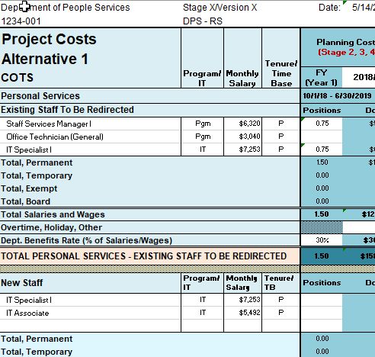
Project Costs (Cont.)
Existing Staff to Be Redirected –
Classifications of existing business program or IT staff resources to be redirected to the project.
New Staff –
Classifications of new business program or IT staff resources needed for the project.

Slide 46
Project Costs (Cont.)
Annual Savings/Revenue Adjustments –
Cost Savings, Cost Avoidances, Increased Program Revenues for each alternative solution under consideration.
Simple Return on Investment (ROI) and Net Cost or Benefit are automatically calculated.
Note: Entry required to show Cost Avoidances or Increased Program Revenues.

Slide 47
Essential Practices Project Costs Worksheet
Use Mid-Range Salary. Use the classification’s mid-range salary for positions needed during your project planning and future operations. This should align with any Budget Change Proposals (BCPs) needed. For more information, contact your Budget staff.
Labels for Fiscal Years. Since each proposal may cover multiple budget years, use the dropdown to label the fiscal years (FYs) of Project Costs to be included (in FY YYYY/YY format). The FYs should align with any Budget Change Proposals (BCPs) needed.
Label each alternative. Since each alternative Project Cost and Future Operations Costs worksheet is formatted similarly, make sure to appropriately label each alternative.
Change decimal to two places after decimal point (as needed). Cells calculate based on entry; however, for viewing purposes, it is helpful to change the “Positions“ cells to two places after the decimal (default only shows one place after decimal).

Slide 48
FAWS TRAINING EXERCISE
FAWS Training Exercise 2:
Planning & Project Costs

Slide 49
Exercise 2 Project Costs Worksheet
The DPS’s recommended alternative is to scan the paper records in the warehouse and store the records in a new electronic content management repository.
PLANNING: The project planning lasts nine (9) months (10/1/18 – 6/30/19) and includes one existing Staff Services Manager (SSM) I ($6,320/mo.), one existing (1) IT Specialist I (mid-range $7,253), and a benefit rate of 30%. For planning, the DPS hires an outside vendor ($75K for nine mos.) to assist with Stages 2 – 4 and also has CDT PAL Mgr. costs of $39,690 ($147*30 hrs. monthly*9 mos.)
PROJECT: The project to last two years, 10 months (7/1/19 – 4/30/22). The DPS needs one new IT Specialist (mid-range $7,253) and one new IT Associate (mid-range $5,492) for the project duration. The DPS will also redirect one SSM I (mid-range $6,320) and one Office Technician (mid-range $3,040) to work on the project. The benefit rate continues to be 30%. Remember to prorate the staff time in FY 2021/22; total Pos./12*mos.
The new repository software is $150K one time (in first project year) and $5K annually after for support. The needed scanning software costs $25K one time (in first project year) and $1K annually after for support. The DPS needs to purchase five new scanners ($1500 each) and all of the storage/servers will be hosted by a cloud services provider at a rate of $2K/per mo. beginning in the first project year. A vendor will be hired to scan all of the paper documents. The vendor charges $5 to scan 100 sheets of paper. There are one million sheets of paper (1,000,000/100 = 10,000 x $5 = $50K). A system integrator is needed to configure the repository, scanning software, and setup the database at an estimated cost of $100K. Prorate FY 2021/22 annual costs as appropriate.
The PM services provided by the CA-PMO ($125K/year; final year prorated for 10 mos. – ($125,000/12*10 or $104,167 and a CDT Oversight Mgr. estimated costs of $119,952 ($147*68*12) per year; final year prorated for 10 mos. – ($147*68*10 or $99,960).

Slide 50
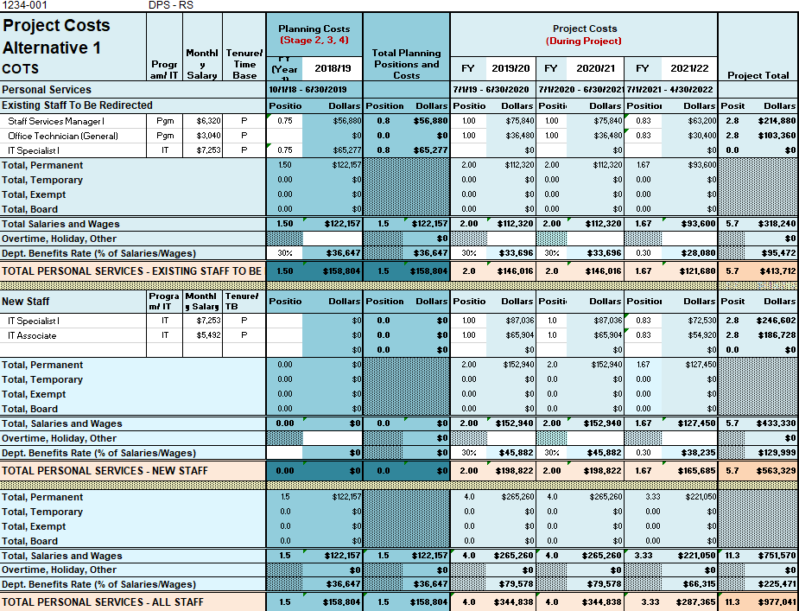
Exercise 2 – Results (1 of 2) Project Costs Worksheet

Slide 51
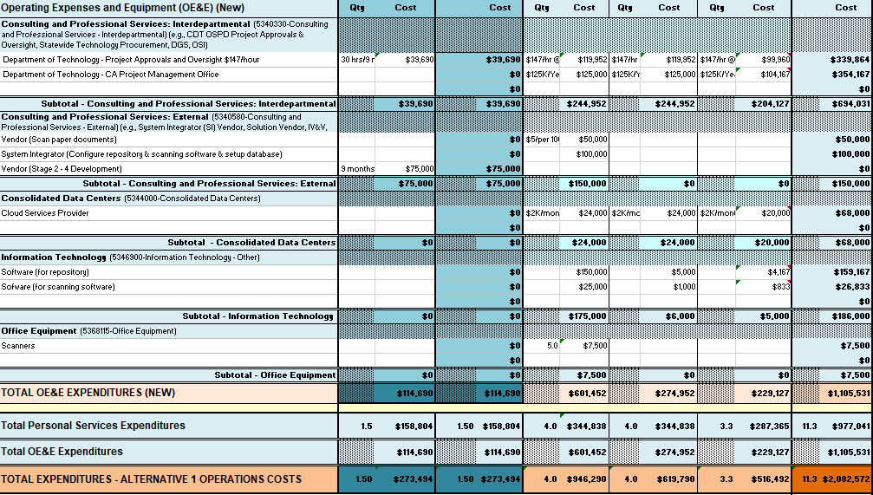
EXERCISE 2 – RESULTS (2 of 2) Project Costs Worksheet

Slide 52
FAWS HANDS-ON
FAWs Hands-On:
Future Operations

Slide 53
Future Operations Worksheets
Intent: Estimate and document the future costs for program operations and supporting information systems for each alternative solution.
Outcome: Presents the total cost of ownership for the proposed alternative and identifies the difference between baseline operations costs and future operations costs.

Slide 54
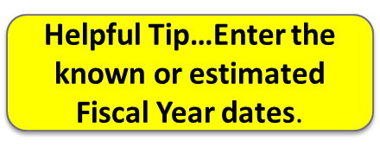
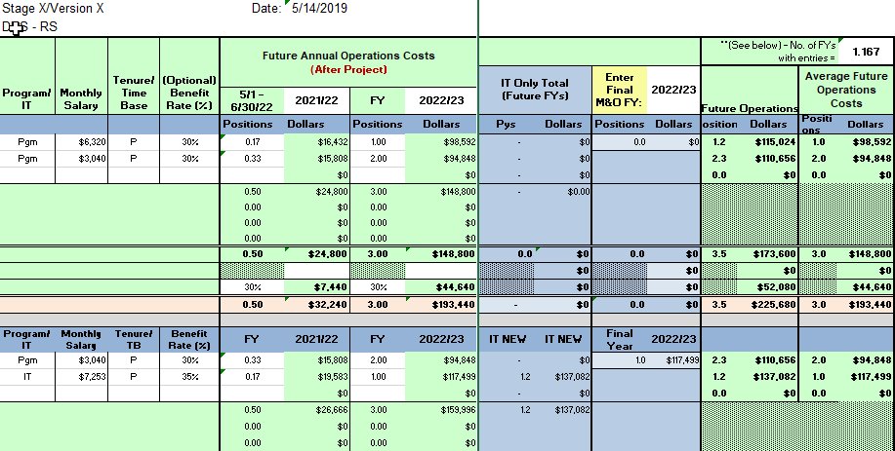
Future Operations Costs (Cont.)
Average Future Operations Costs – Average of multi-year operations cycles after alternative has been implemented.
IT Only Total (Future FYs) – Totals the IT salaries and benefits for all full FYs plus any Overtime, Holiday, Other, and all OE&E.
IT Only Total (Future FYs) – Totals the IT positions, salaries and benefits for all full FYs plus any Overtime, Holiday, Other, and all OE&E.
Enter Final M&O FY – Once entered, automatically totals the IT salaries and benefits for the final FY plus any Overtime, Holiday, Other, and all OE&E.

Slide 55
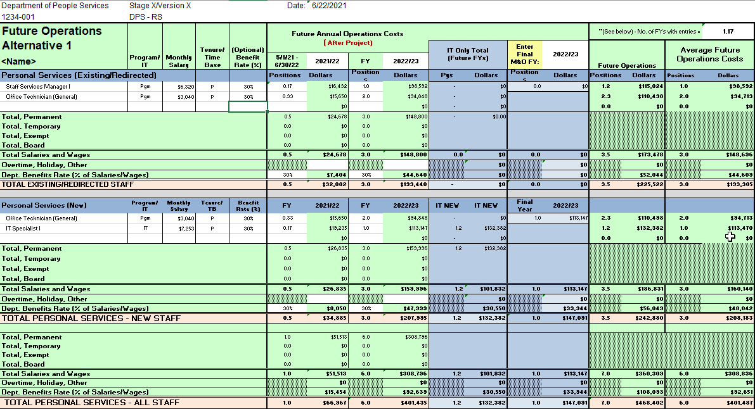
Optional Benefit Rate (%) Use
Optional Benefit Rate (%) Use
Important! If you use the Optional Benefit Rate, make sure you have not entered in both the “Optional Benefit Rate” and “Dept. Benefits Rate (% of Salaries/Wages)”:
When both are entered, the lookup table multiplies the total salary ($7253 * positions * 12 months * 30%) and then adds an additional 30% on the total IT salaries, which inflates the total Annual Fut. Ops. IT Costs (M&O Costs).
In this example, the IT position earns $7253 per month or $87,036 for a full FY. By adding the Optional Benefits Rate AND the Dept. Benefits Rate, the IT positions total FY salary includes an inflated 30+%.

Slide 56
Optional Benefit Rate (%) Use
Optional Benefit Rate (%) Use
Important! If you use the Optional Benefit Rate in the Future Ops worksheet, make sure you have not entered both an “Optional Benefit Rate” and a “Dept. Benefits Rate (% of Salaries/Wages)”:
WITH ONLY ONE BENEFIT % INCLUDED:
WITH BOTH THE OPTIONAL BENEFIT RATE & DEPT. BENEFITS RATE INCLUDED:

Slide 57
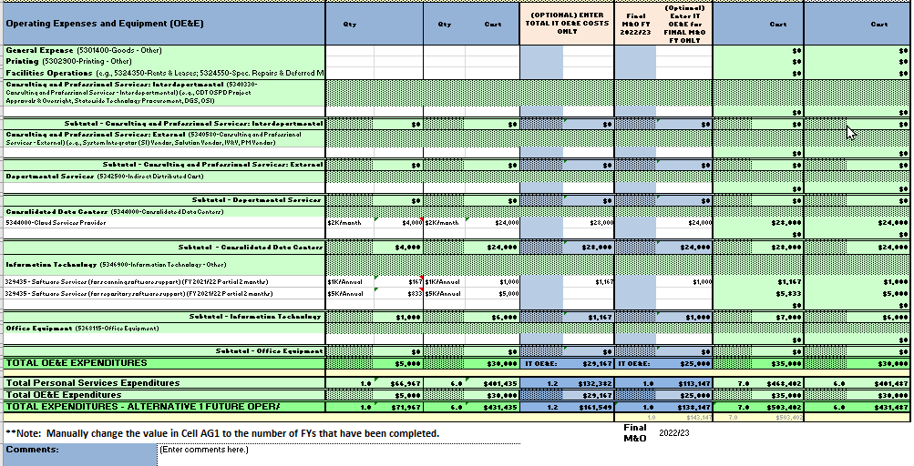
Optional IT OE&E Only Columns
Important! Only use the “Optional” blue section if the Operating Expenses and Equipment amounts lists are NOT to be included in your ongoing future operational costs. In most cases, no entry will be needed in the “(Optional) Enter Total IT OE&E Costs Only” and “Optional) Enter IT OE&E for FINAL M&O IT Only”.
In this example, the department had already included the Software Services (for repository/software support) with program-related costs.
If used, all totals must be re-entered in the blue columns that are needed for the IT solution.

Slide 58
Optional IT OE&E Only Columns
Important! If you use the Optional IT OE&E Only columns AA & AC, you must MANUALLY enter the OE&E totals for all future years (Column AA) and the final M&O year (Column AC) in the blue columns of the Future Ops worksheet. No entry is needed if all OE&E costs listed in the Future Ops sheet are to be included.
TOTAL FUTURE COSTS WITHOUT THE OPTIONAL OE&E COLUMNS USED (NO ENTRY IN BLUE COLUMNS):
TOTAL FUTURE COSTS WITH THE OPTIONAL OE&E COLUMNS USED:

Slide 59
Optional IT OE&E Only Columns
Important! Only use the “Optional” blue section if the Operating Expenses and Equipment amounts lists are NOT to be included in your ongoing future operational costs. In most cases, no entry will be needed in the “(Optional) Enter Total IT OE&E Costs Only” and “Optional) Enter IT OE&E for FINAL M&O IT Only”.

Slide 60
FAWS TRAINING EXERCISE
FAWS Training Exercise 3:
Future Operations

Slide 61
Exercise 3 Future Costs Worksheet
The project goes live on 5/1/2022. The partial FY costs (from 5/1 – 6/30/2022) during maintenance and operations (M&O) need to be captured. Therefore, prorate FY 2021/22 costs as appropriate. The final M&O FY year (FY 2022/23) (when M&O costs are stable with no fluctuations for a period of 12 months) provides the total annual future M&O costs.
Costs: In order to operate and support the recommended alternative, the department will not need any of the Warehouse Workers. They will retain the one Staff Services Manager I (mid-range $6,320) and both of the Office Technicians (mid-range $3,040). The Department will need two new Office Technicians (mid-range $3,040) to scan future documents and one new Staff Information Systems Analyst (mid-range $6,130) to maintain the new system. Staff benefits continue at a rate of 30%. The warehouse will be closed, paper will no longer be purchased, and the microfiche machine will no longer be needed. Cloud services, repository, and scanning software support costs will continue in future annual operations.

Slide 62
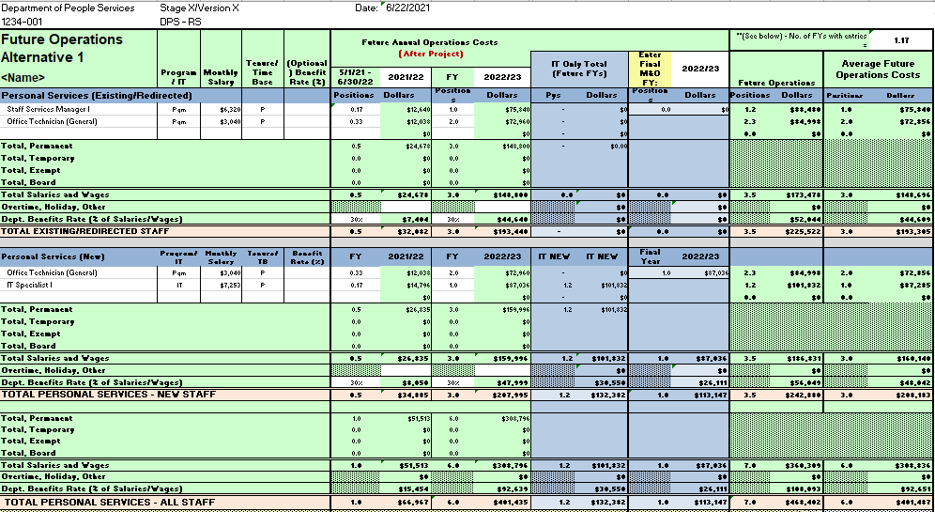
Exercise 3 – Results (1 of 2) Future Annual Costs Worksheet

Slide 63
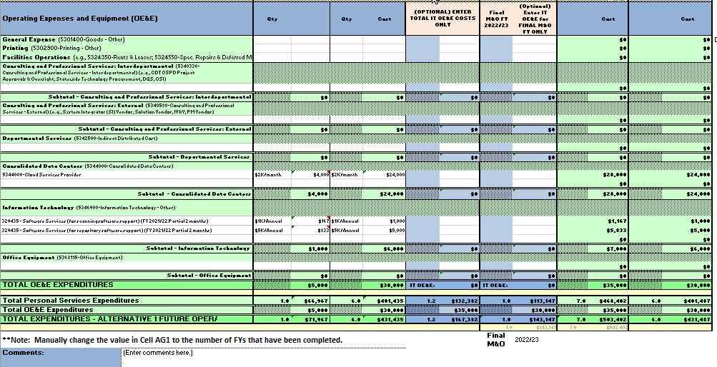
Exercise 3 – Results (2 of 2) Future Annual Costs Worksheet

Slide 64
FAWS HANDS-ON
FAWs Hands-On:
Funding Plan

Slide 65
Funding Plan Worksheet
Intent: Identifies the funding sources, savings, and/or revenues that may be achieved through the implementation of the proposed alternative.
Outcome: Provides a comprehensive funding plan for the proposed alternative including how all Project Costs will be funded through redirected resources, adjustments, and/or various funding sources.

Slide 66
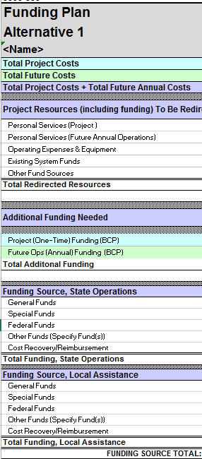
Funding Plan (Cont.)
Funding Plan (Cont.)
Total Project Costs and Total Future Costs – Derived from information inputted into the Project Cost Alternative and Future Annual Ops. Worksheet
Resources – Current operations resources to be redirected and utilized for project or future operations of the new system.
Annual Funding Needed – Project (One-Time) (BCP) funding and Future Operations (Annual) (BCP) funding needed.
Funding Source – Breakdown for how selected alternative will be funded, by percentage for each year.
Funding Source, Local Assistance – Breakdown for how selected alternative’s local assistance will be funded, by percentage for each year.

Slide 67
FAWS TRAINING EXERCISE
FAWS Training Exercise 4:
Funding Plan

Slide 68
Exercise 4 Funding Plan
Any cost savings from current operations will be redirected to help fund the new process. Half of any additional funding will be provided through the General Fund and the remaining funding will be provided though Special Funds.
Be sure Row 24 “Total Additional Funding” matches funding requested in the BCP.
Remember to add any Future FYs not already contained in the blue “Project Costs” section to the green “Future Annual” section. Add percentages to the “Funding Source, State Operations” section as needed.

Slide 69
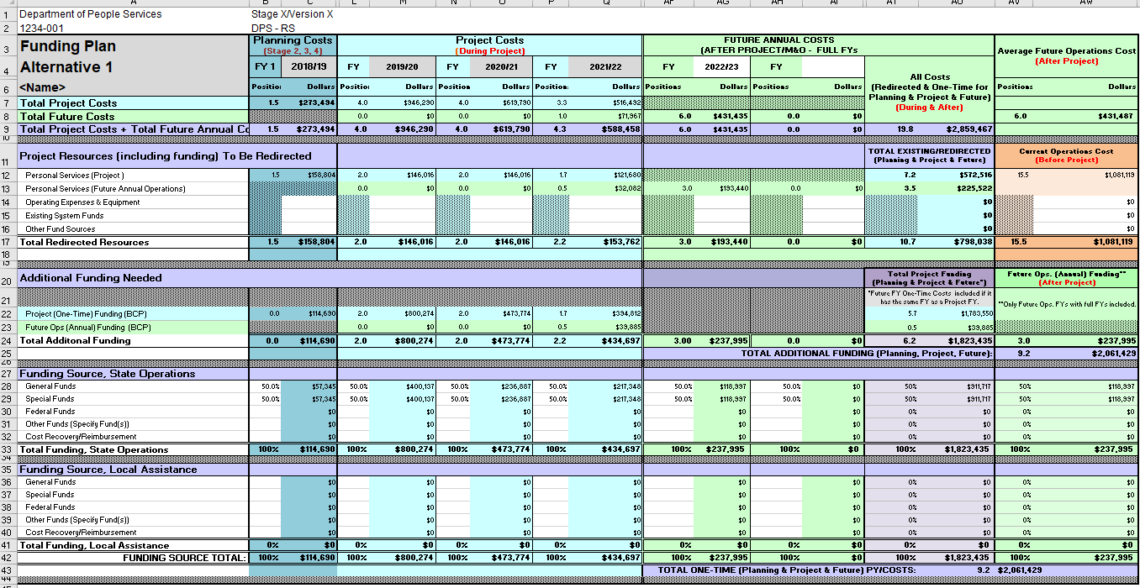
Exercise 4 – Results Funding Plan

Slide 70
Exercise 4 – Results Funding Plan Where do the amounts come from?
Excerpt Alt 1- Project, Row 356
Excerpt Alt 1- Future Ops, Row 363
Excerpt Alt 1- Project, Row 126 Existing Redirected Staff
Excerpt Alt 1- Future Ops, Row 125 Existing Redirected Staff

Slide 71
FAWS HANDS-ON
FAWs Hand-On:
BCP Worksheet Tools

Slide 72
BCP Worksheet Tools
Intent: Provide a tool to assist in the development of BCPs.
Outcome: Additional documentation to validate and verify BCP information.

Slide 73
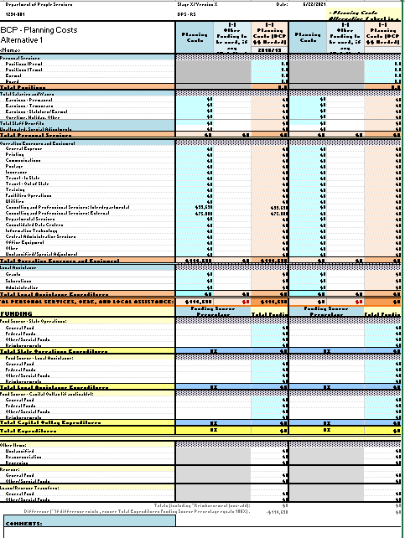
BCP Worksheet Tools
Automatically pre-populates all totals based on the Alt 1 worksheets. Entry needed only if a department uses other existing funding sources to fund the project. Note: The totals on the BCP worksheets should align with Row 24 of the Funding Plan.

Slide 74
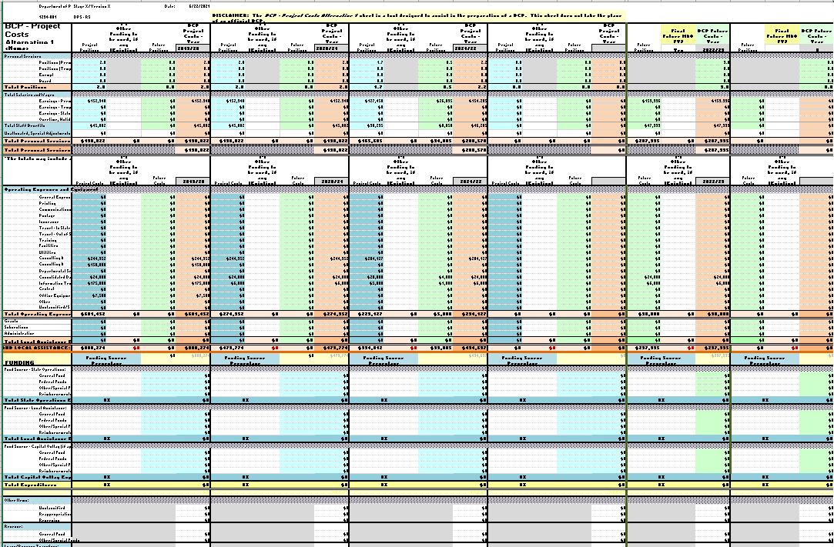
BCP Worksheet Tools
Automatically pre-populates all totals based on the Alt 1 worksheets. Entry needed only if a department uses other existing funding sources to fund the project. Note: The totals on the BCP worksheets should align with Row 24 of the Funding Plan. Note: Columns hidden for viewing.

Slide 75
FAWS REVIEW CRITERIA & TIPS
REVIEW CRITERIA & TIPS

Slide 76
Review Criteria
The following questions will be asked of the Financial Analysis Worksheets:
Does the description information for the top 3 alternatives align with section 2.10 Alternative Solutions?
Does the existing cost worksheet align to section 2.5 Baseline Processes and Systems?
Does the Funding Plan percentage vertically total 100% by section/budget year?
Do the staffing and resources indicated cover the activities in all project phases outlined in section 2.11 Recommended Solution and 2.12 Staffing Plan?
Does the baseline costs in the Stage 4 Section 4.13 match may FAWs? Did I explain why there are any differences between my Stage 2 estimate to the final Stage 4 baseline costs?

Slide 77
FAWS Tip
You may use formulas in the areas where you enter information.
To determine partial year full-time Position equivalents (i.e., planning or project or maintenance and operations activities DO NOT begin on July 1 in a particular Fiscal Year), departments may use the following format in the “Positions” field:
(Number of positions multiplied by the number of months divided by 12). The example below is the formula for two positions for nine (9) months (October – June 30):
=2*(9/12)(Result will be 1.5)

Slide 78
FAWS Tip
Ensure accurate average costs in the Current Operations and Future Operations sheets. Be sure the number of years with cost information equals the upper right hand column “Number of Years with entries.”
The example below should be three years:

Slide 79
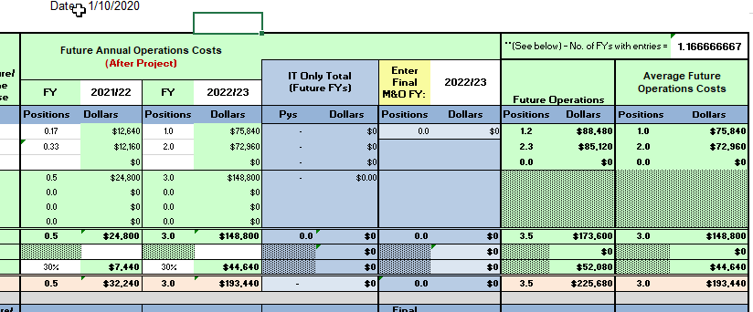
FAWS Review Criteria/Tip Future Ops
Hide/unhide Rows/Columns as needed.
Be sure to enter your FINAL Full M&O Year on the Future Operations sheet.

Slide 80
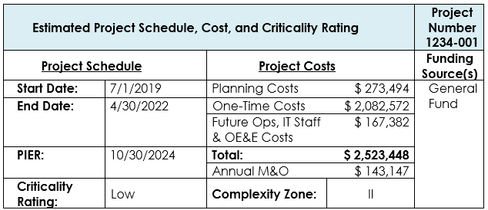
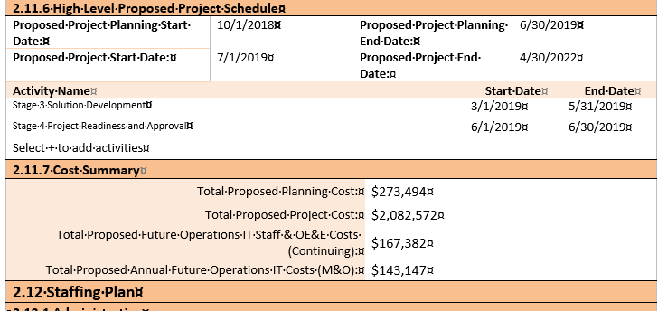
FAWs, Approval Letter, and S2AA Stage 2 Costs
FAWs, Approval Letter, and S2AA
Stage 2 Costs
Approval Letter
FAWs
Stage 2 costs must match:
Final Stage 2 FAWS
Final S2AA Section 2.11.7 Cost Summary
Stage 2 Approval Letter.
S2AA
Notes:
Attach your FAWs. No entry required in the Department of Technology Use Only section.

Slide 81
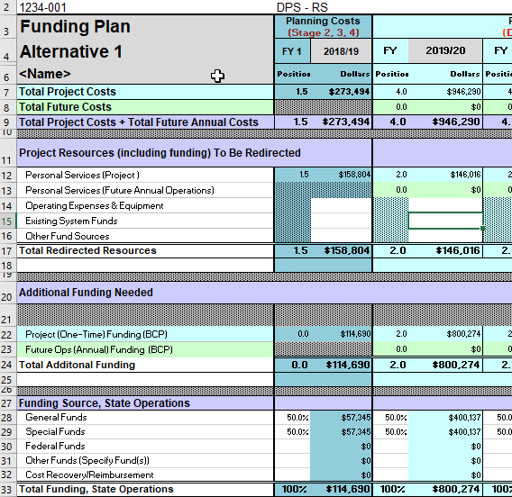
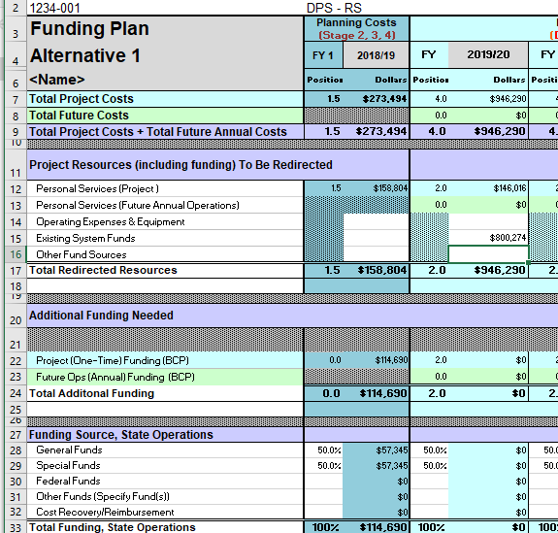
FAWS Review Area & Tip Funding Plan
Funding Plan Rows 14 – 16 may be used to reduce the funds needed and reduce the amount shown in Row 24. Note: If this is used, an explanation is needed for the availability of existing funds, other funds, or OE&E.
Example C

Slide 82
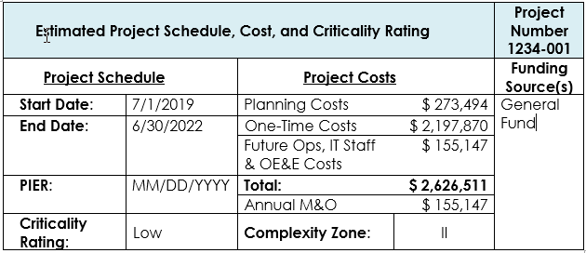
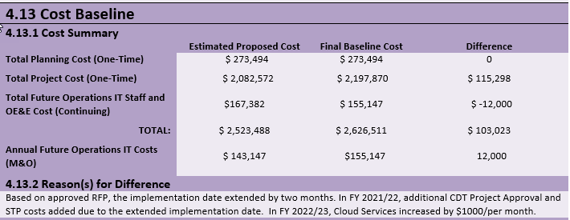
FAWs, Approval Letter, and S4PRA Stage 4 Costs
FAWs, Approval Letter, and S4PRA
Stage 4 Costs
Approval Letter
FAWs
Stage 4 costs must match:
Final Stage 4 FAWS
Final S4PRA Section 4.13 Cost Baseline
Stage 4 Approval Letter.
S2AA
Notes:
Attach your FAWs. No entry required in the Department of Technology Use Only section.

Slide 83
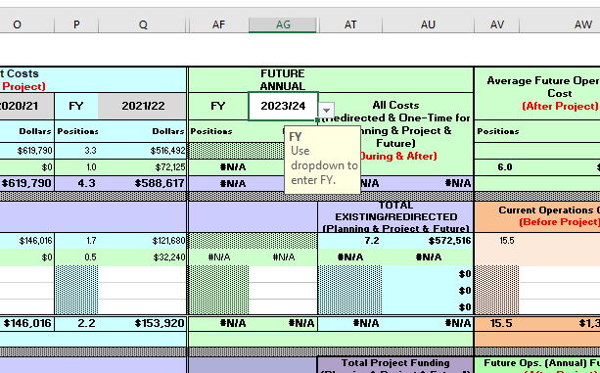
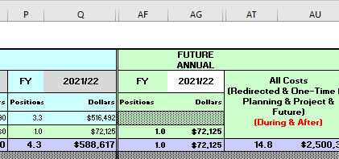
FAWS Review Criteria/Tip Funding Plan
If the Funding Plan sheet indicates “#N/A,” a invalid Fiscal Year was entered and must be changed. (See Example A)
Make sure that at least one Fiscal Year is entered in the Funding Plan Future Annual column. (See Example A & B)
Do not repeat a Fiscal Year that is already showing in Project Costs. The FAWs were designed to combine Project and Future Operations costs that overlap into a single Fiscal Year. (See Example B.)
Example A
Example B

Slide 84
FAWS SAMPLE
Sample

Slide 85
Single Systems Integrator Solution
Open files, “9999-015 CDTR SPSIVS.xls” and “9999-015 CDTR SPSIVS.doc”

Slide 86
Single Systems Integrator Solution
Open files, “9999-015 CDTR SPSIVS.xls” and “9999-015 CDTR SPSIVS.doc”

Slide 87
LINKS & ATTACHMENTS
Links & Attachments

Slide 88
LINKS AND ATTACHMENTS
PROJECT APPROVAL LIFECYCLE RELATED
Statewide Information Management Manual (SIMM) (https://cdt.ca.gov/policy/simm/)
SIMM 05 Reporting Schedules (https://cdt.ca.gov/wp-content/uploads/2018/06/SIMM-05A.pdf)
SIMM 19 Project Approval Lifecycle (https://cdt.ca.gov/policy/simm-19/)
F.1 Preparation Instructions (https://cdt.ca.gov/wp-content/uploads/2019/07/F.1-Preparation-Instructions.pdf)
F.2 Financial Analysis Worksheets Template (https://cdt.ca.gov/wp-content/uploads/2019/09/F.2-Financial-Analysis-Worksheets-Template-1.xlsx#a11y=)

Slide 89
LINKS AND ATTACHMENTS
BUDGET RELATED
Budget Resources For Departments (ca.gov)
https://www.dof.ca.gov/budget/resources_for_departments/
Budget Letters (ca.gov)
https://www.dof.ca.gov/budget/Budget_Letters/
BL19-06 2020-21 Budget Preparation Guidelines
(https://www.dof.ca.gov/budget/Budget_Letters/documents/BL19-06.pdf)
BL20-27 IT Project Planning BCP Reporting Requirement
https://www.dof.ca.gov/budget/Budget_Letters/documents/BL20-27_Control_Section_11-00.pdf
BL20-27 Attachment DF12 (https://www.dof.ca.gov/budget/Budget_Letters/documents/BL20-27_Attachment.docx)
BL20-28 IT Project Planning BCP Reporting Requirement
(https://www.dof.ca.gov/budget/Budget_Letters/documents/BL20-28_Information_Technology_Project_Planning.pdf)
BL20-28 Attachment DF576
(https://www.dof.ca.gov/budget/Budget_Letters/documents/BL20-28_Attachment.xlsx)
BL20-30 2021-22 Budget Policy
(https://www.dof.ca.gov/budget/Budget_Letters/documents/BL20-30.pdf)
BL20-38 Governor’s Budget Supplementary Schedules
(https://www.dof.ca.gov/budget/Budget_Letters/documents/BL20-38.pdf)

Slide 90
LINKS AND ATTACHMENTS
Attachments –
9999-015 CDTR SPSIVS Project FAW
9999-015 CDTR SPSIVS S4PRA Approval Letter
F.1 Preparation-Instructions.pdf
F.2-Financial Analysis Worksheets-Template
BL19-06, BL20-027, BL20-27 Attachment, BL20-28, BL20-28 Attachment, BL20-30, BL20-38

Slide 91
Financial Analysis Worksheets Q&A
Financial Analysis Worksheets Q&A
Questions?
Notes:
Any questions or comments…?

Slide 92
Thank You!
Contact Us @ projectoversight@state.ca.gov
Notes:
Thank you for your time and participation. We hope this discussion will be helpful as you continue your project planning and PAL activities.

